Slide 1


DESIGN 1
Lesson 4: Formative Assessment: Hyperlinks & Navigation Task
Ms. Abboud • Grade 9 - Design 1 • Term 1, Week 5

Slide 2
Learning Objectives
WALT - We Are Learning To
WILF - What I'm Looking For
Demonstrate correct, independent creation of working hyperlinks.
Build and test site navigation for this week's formative.
I create working hyperlinks.
I link webpages successfully.
I navigate efficiently between pages.

Slide 3
Frayer Model: Hyperlink (Review)
DEFINITION
CHARACTERISTICS
Clickable text or an image that takes the user to another webpage or location when clicked.
Clickable; takes the user somewhere else; created with <a>.
HYPERLINK
EXAMPLES
NON-EXAMPLES
A "Home" link in a navigation menu.
Plain unclickable text; an image with no <a> wrapper.

Slide 4
National Identity Integration
UAE Government Digital Services: government portals must link every service reliably, because a broken link can stop a resident from reaching the help they need. Today you prove your links work.

Slide 5
STARTER
Spot the Bug
<a href="about">About</a>
<a href="Contact.html">Contact</a> (the file is contact.html)
<a href=https://u.ae>UAE Portal</a>
Hook • Engage & Ask
5 - 10 minutes

Slide 6
LESSON CORE
I Do: The Task and Rubric
Part of the Hyperlinks, Images & Tables Activities formative (10 pts). Today counts toward Working hyperlinks & navigation (4 pts).
Requirements: 3+ pages, the same <nav> menu on every page, 1+ absolute link opening in a new tab, every link tested.
Gradual Release of Responsibility
30 - 40 minutes
1 / 2

Slide 7
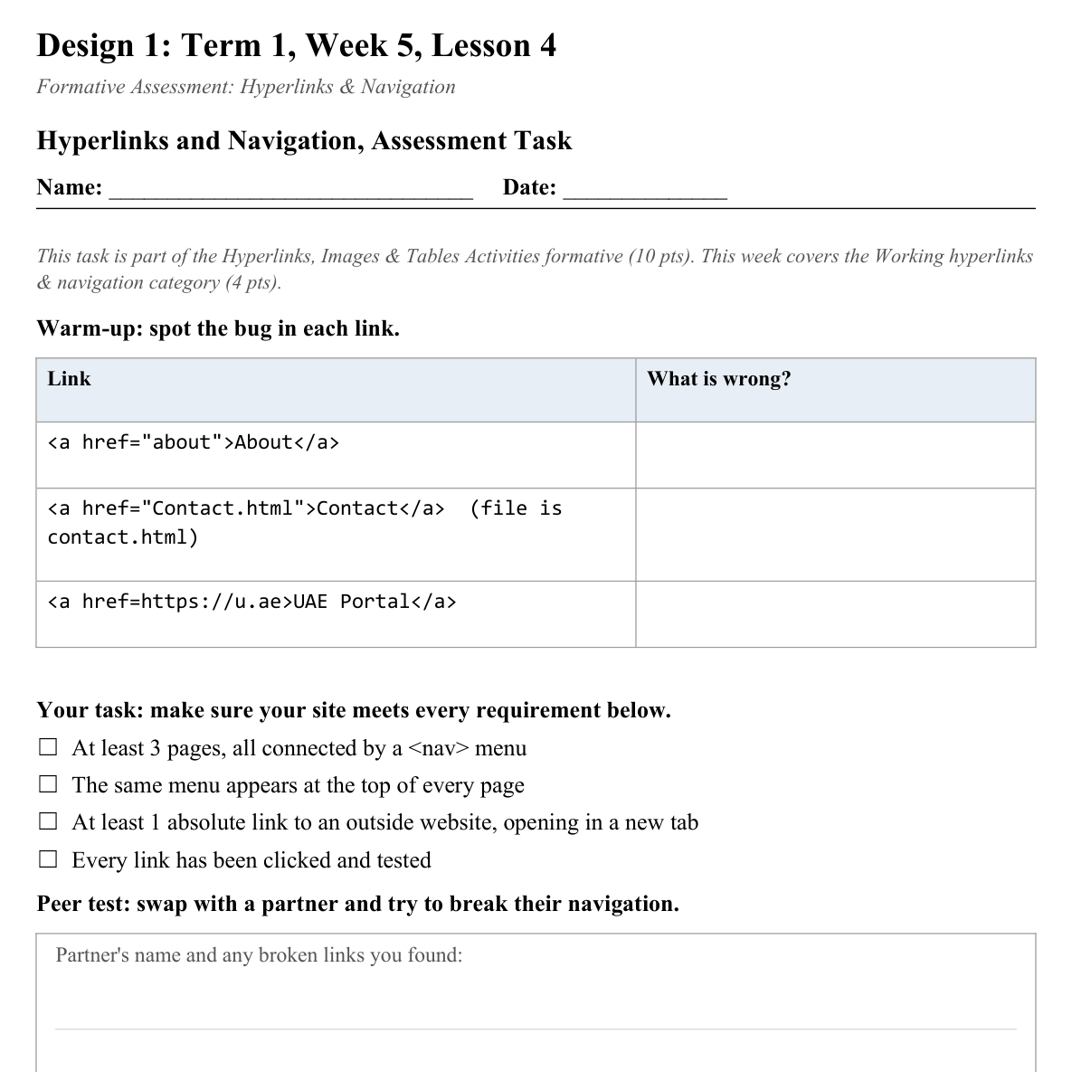
LESSON CORE
You Do: Build, Test, Swap
Complete the task on your own site.
Swap with a partner and try to break their navigation.
Submit your evidence via Toddle.
Activity: Hyperlinks and Navigation, Assessment Task
Gradual Release of Responsibility
30 - 40 minutes
2 / 2

Slide 8
CLOSURE
Exit Ticket
One navigation design choice from a real website you want to copy for your own site.
Transition & Extend
5 - 10 minutes

